Slide 1
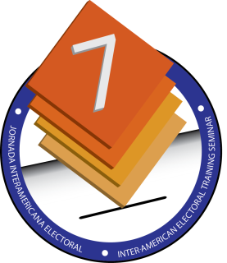
Four Key Strategies for Disability-Inclusive Elections and Political Processes
Virginia Atkinson
Access and Inclusion Specialist
International Foundation for Electoral Systems (IFES)

Slide 2
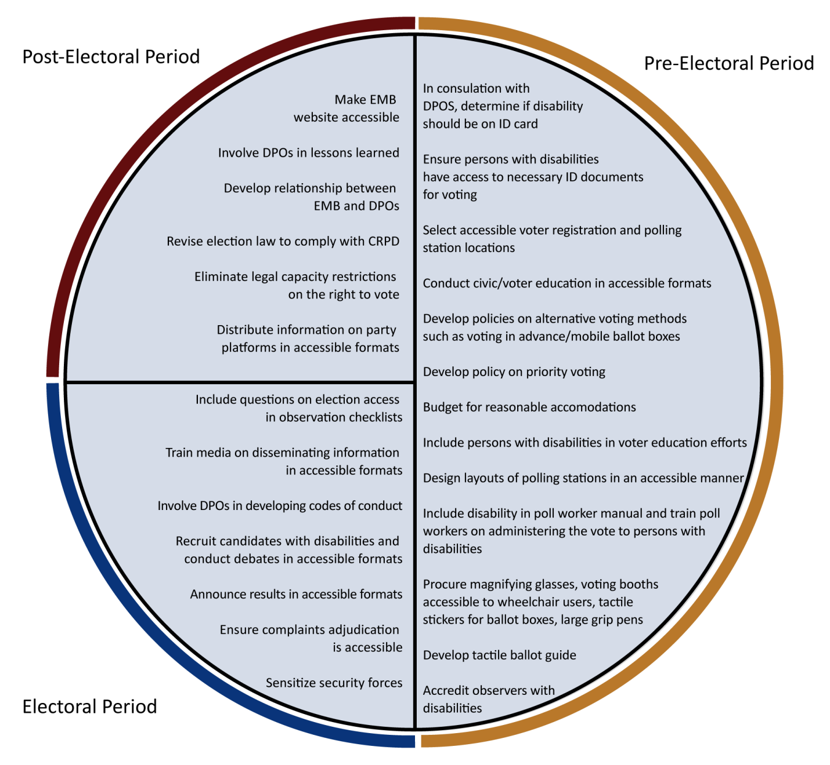
Disability Inclusion and the Electoral Cycle

Slide 3
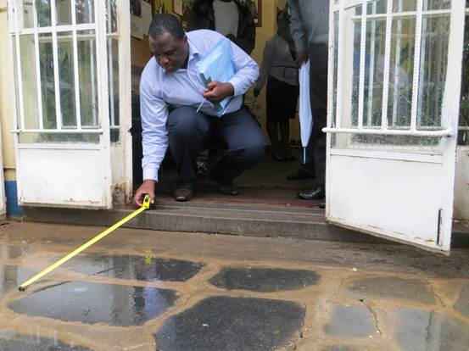
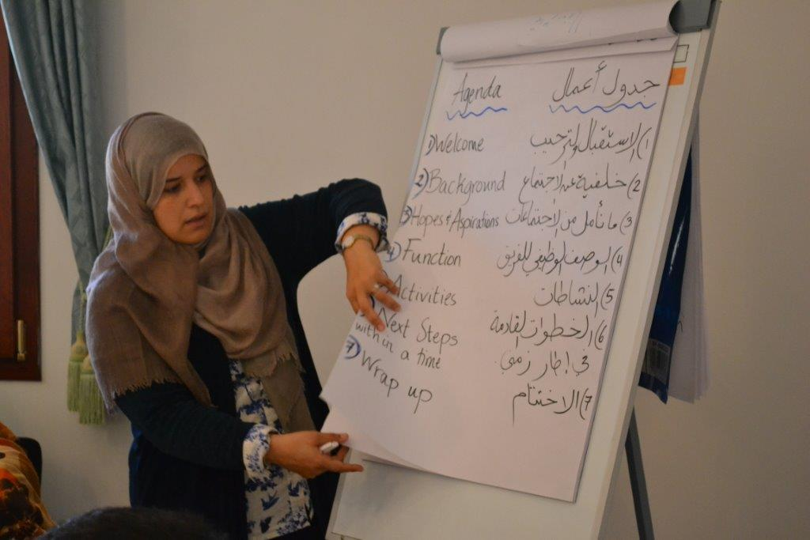
1. Empower people with disabilities

Slide 4
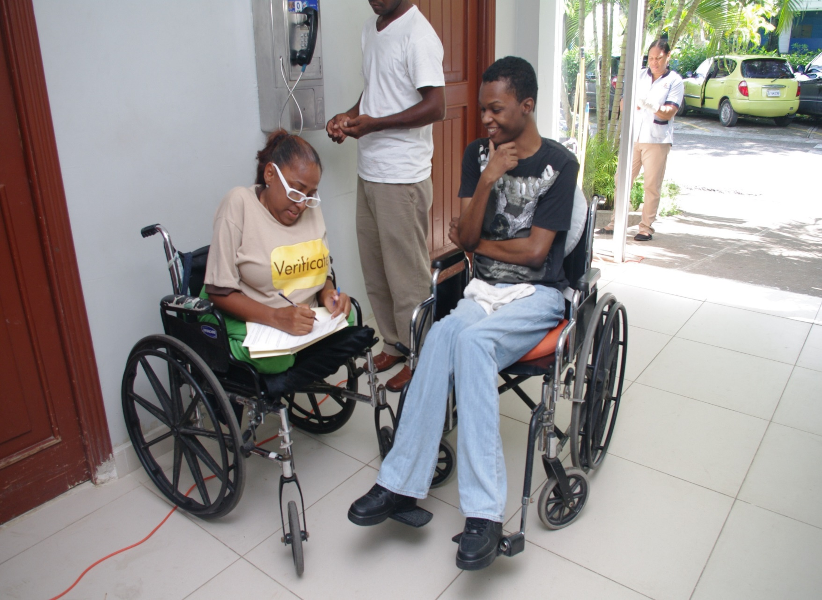
Leadership
Contenido

Slide 5
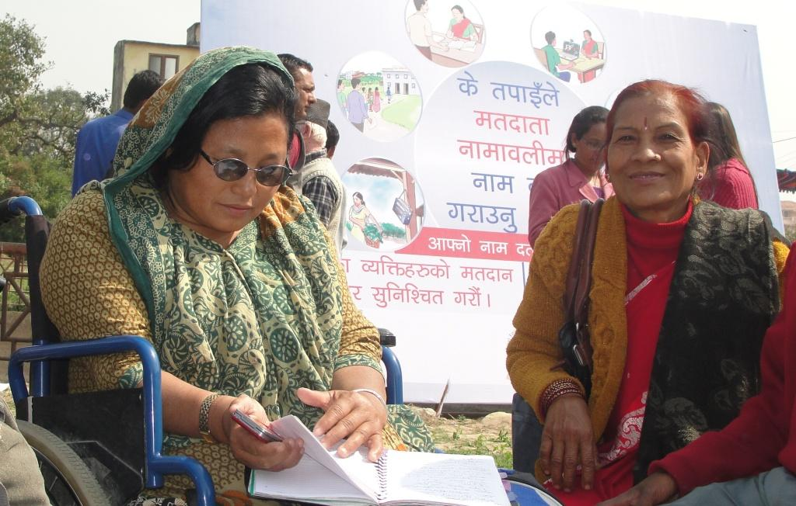
2. Develop accessible EMB policies and procedures

Slide 6
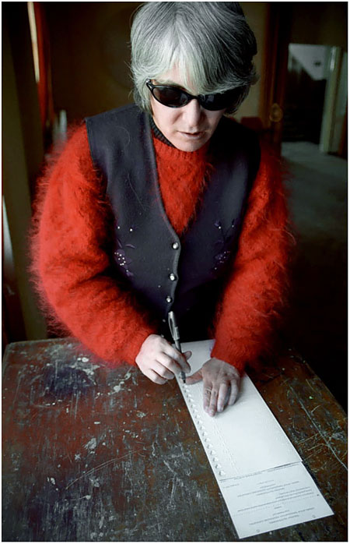
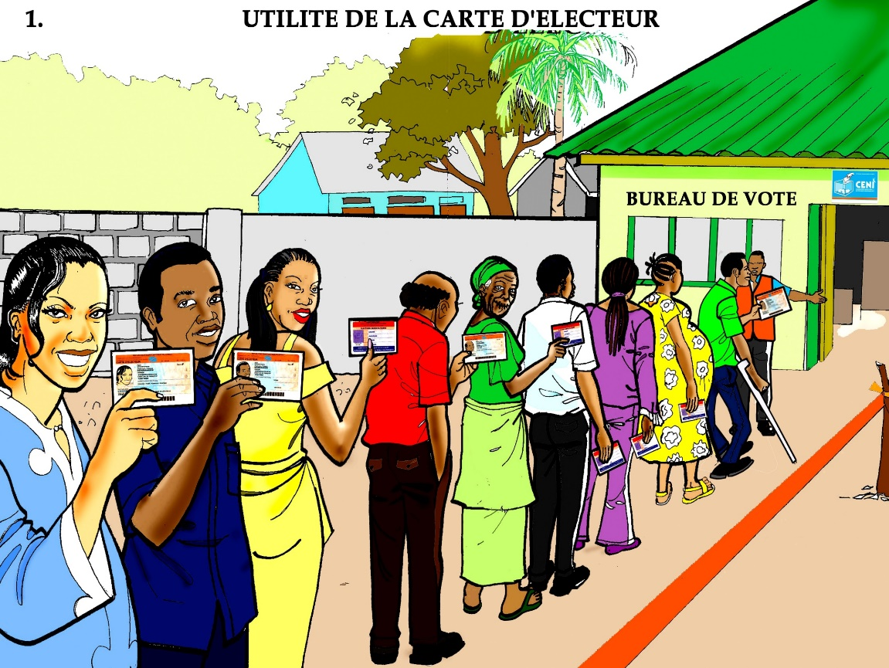
Include people with all types of disabilities

Slide 7
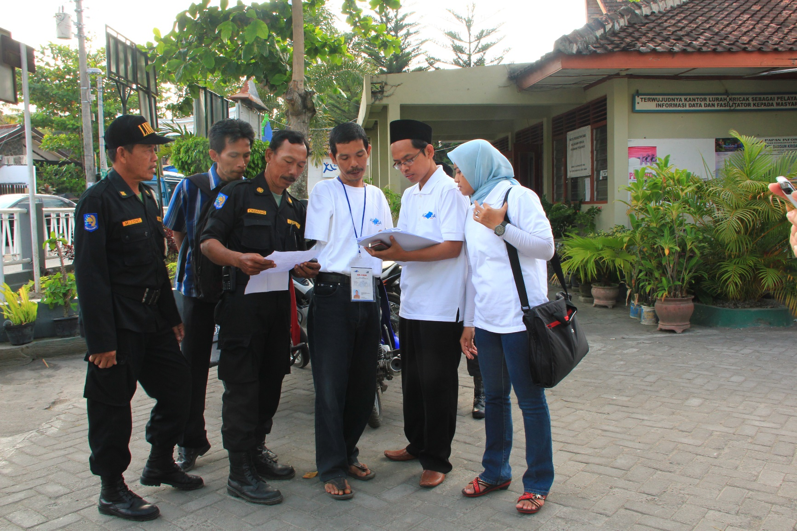
3. Form partnerships between DPOs and CSOs

Slide 8
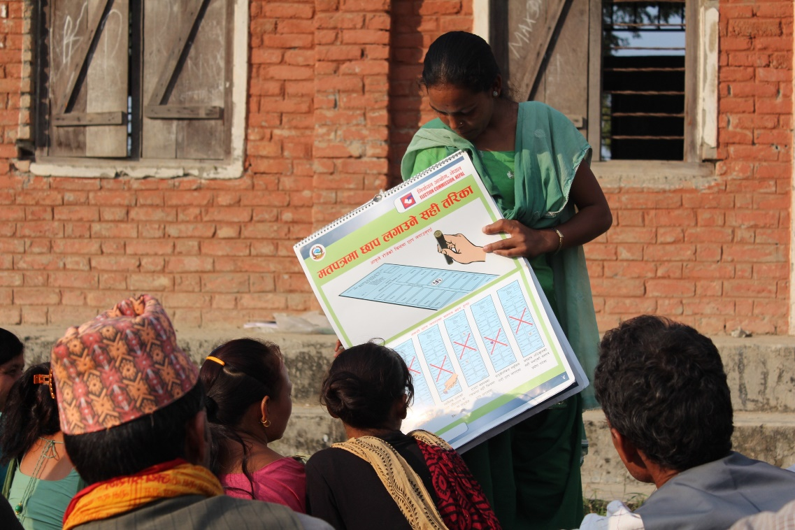
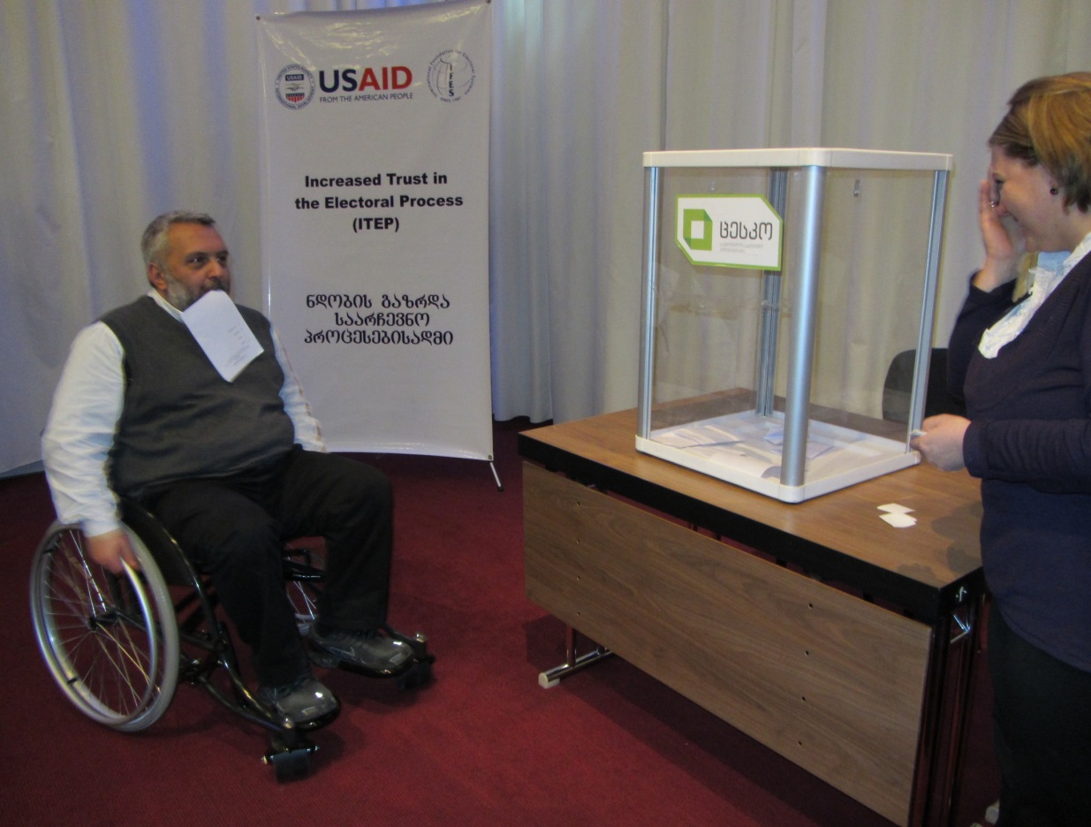
Simulations and community faciliators

Slide 9
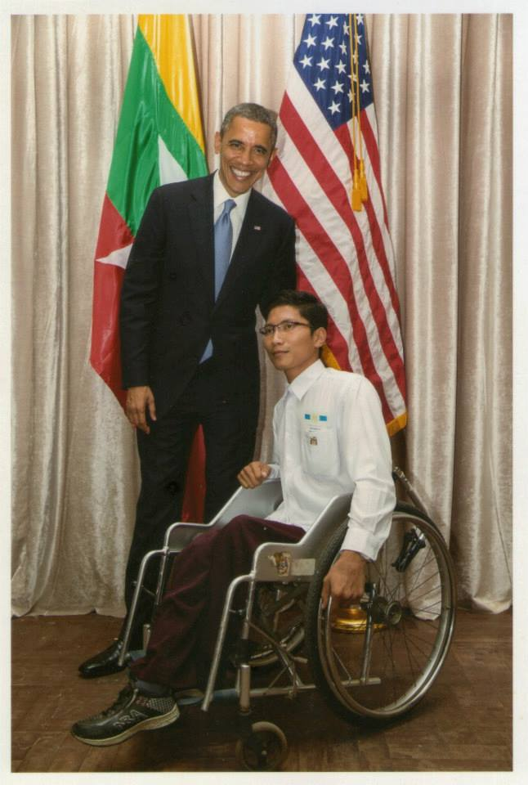
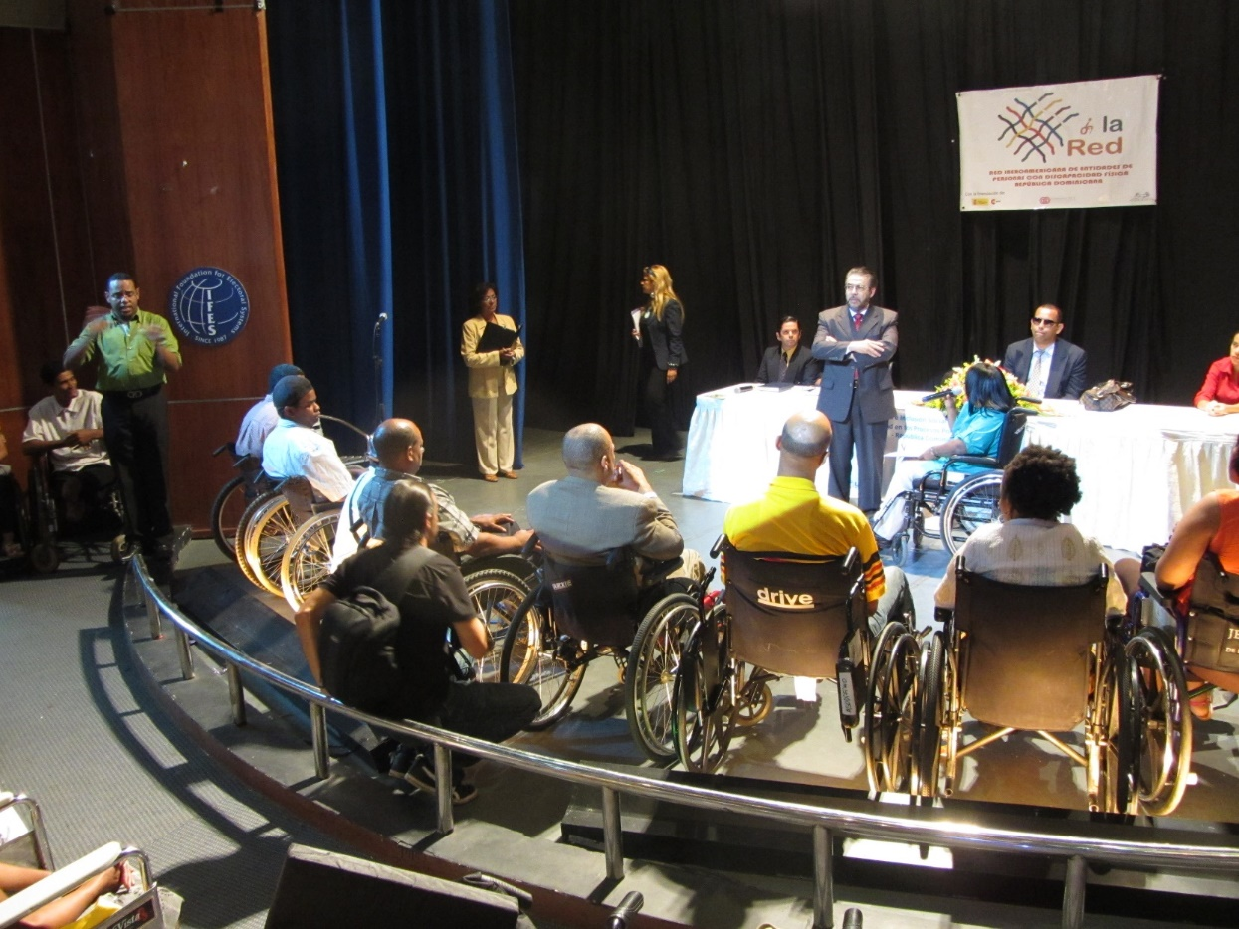
4. Advocate with political parties and elected officials

Slide 10
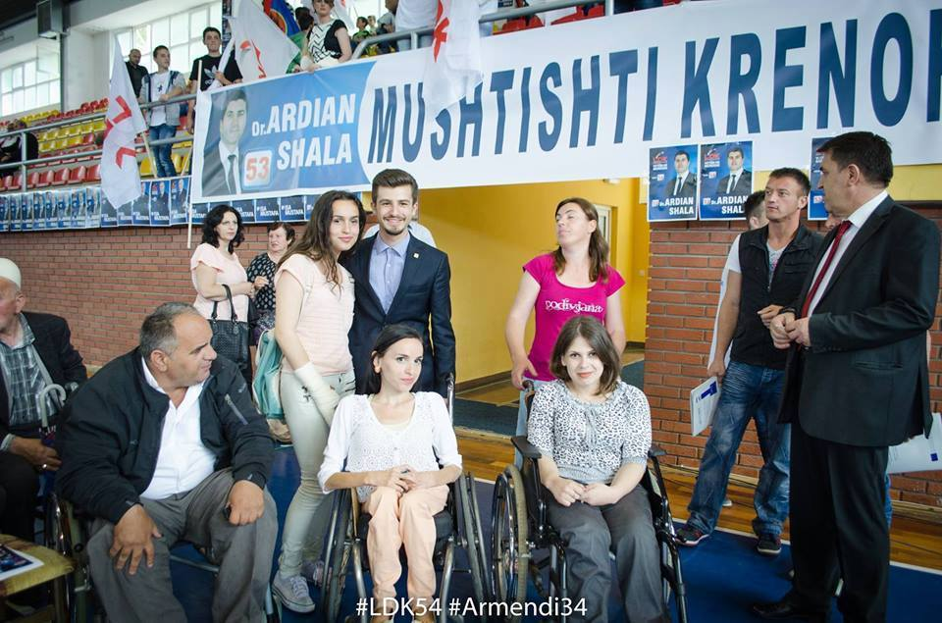
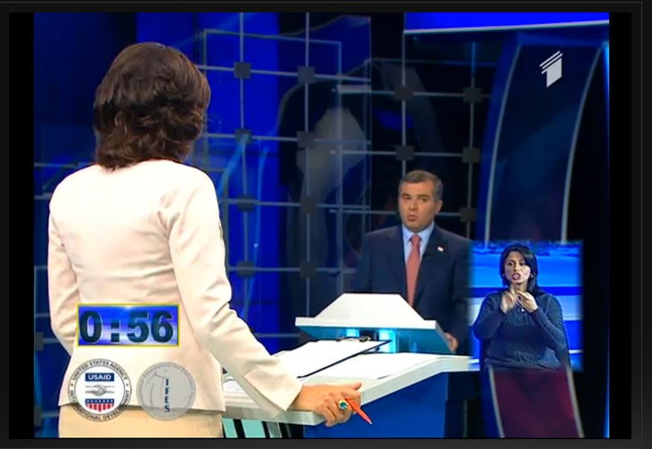
Campaigns and debates

Slide 11
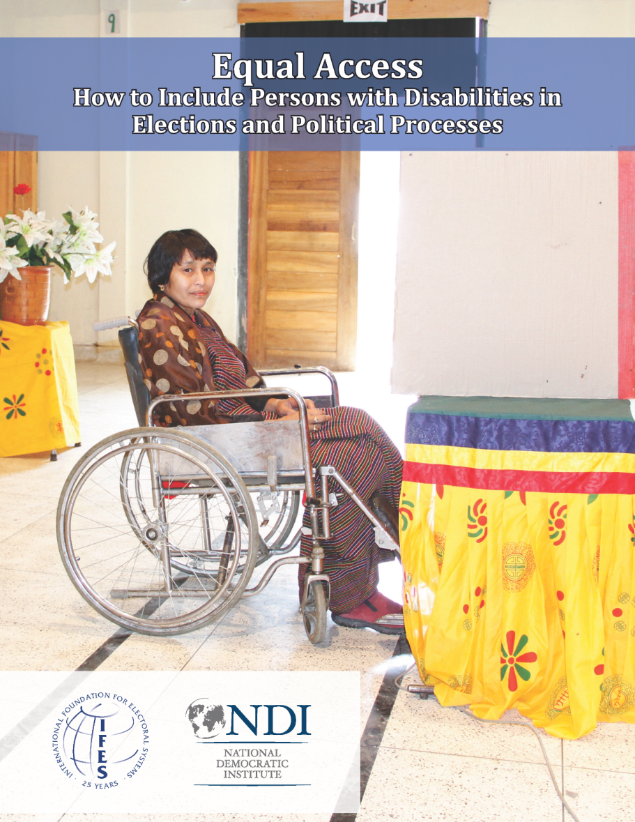
Thank you!
To download Equal Access: How to Include Persons with Disabilities in Elections and Political Processes, please visit IFES.org
For questions or comments, feel free to email me: vatkinson@ifes.org

